Slide 1
Paraphrasing without Plagiarism
It’s not just a good idea; it’s the law!

Slide 2

“Move Over Meerkat Manor”

Slide 3
Plagiarism is Wrong!
Don’t borrow another person’s paper.
Don’t have someone else write your paper.
Don’t buy a paper.
Watch out that nobody “over-corrects” your paper.

Slide 4
Paraphrasing
You can still be guilty of plagiarism if you do not paraphrase correctly!

Slide 5
My Story
Sometime in the early part of 1910, Agnes Sloan Nibley attended the Salt Lake Temple. She was in the middle of a difficult pregnancy and most likely went to the temple seeking peace and comfort. While she was there, President John R. Winder, president of the temple and First Counselor to President Joseph F. Smith, approached her and asked to give her a blessing. In that blessing, President Winder spoke about the son Sister Nibley would soon deliver, stating that he would accomplish and important work. On March 27 of that year, President Winder died. According to the Nibley family story, with his parting words President Winder inquired whether Sister Nibley had yet given birth to her son. Significantly, the Nibleys’ son was born that very day, and, in honor of President Winder, the baby boy was named Hugh Winder Nibley.
--Boyd Petersen. “Youth and Beauty: The Correspondence of Hugh Nibley.” BYU Studies 37.2 (1997-98): 7.

Slide 6
Winder Biography
President Winder was a spiritual giant, as one would expect from a First Presidency member and president of the Salt Lake Temple. One anecdote regarding his inspiration is particularly interesting. Sometime in the early part of 1910, Agnes Sloan Nibley, daughter-in-law of Winder’s friend Charles W. Nibley, the Presiding Bishop, attended the Salt Lake Temple. She was in the midst of a difficult pregnancy and most likely went to the temple seeking peace and comfort. While she was there, President John R. Winder approached her and asked to give her a blessing. In that blessing, President Winder spoke about the son Sister Nibley would soon deliver, stating that he would accomplish an important work. According to the Nibley family story, some of Winder’s final words as he lay dying on March 27 of that year were inquiring whether Sister Nibley had yet given birth to her son. Significantly, the Nibleys’ son was born that very day, and, in honor of President Winder, the baby boy was named Hugh Winder Nibley. Hugh Nibley would grow to become one of the greatest LDS philosophers of the twentieth-century.
(Footnote: Boyd Petersen, ed, Oral History of Hugh Nibley, 7.)
Michael Winder, John R. Winder: Leader Pioneer, Builder, Dairyman (Bountiful: Horizon, 1999), 208.

Slide 7
Original
From James W. Fowler’s Stages of Faith (San Fransico: Harper, 1981): 18.
Idolatry is the profoundly serious business of committing oneself or betting one’s life on finite centers of value and power as the source of one’s (or one’s group’s) confirmation of worth and meaning, and as the guarantor of survival with quality.

Slide 8
Plagiarized paraphrase
For James W. Fowler, idolatry is the profoundly serious issue of dedicating oneself to finite centers of value and power as the source of one’s confirmation of worth and meaning, and as the guarantor of survival with quality (18).

Slide 9
Compare
Original:
Idolatry is the profoundly serious business of committing oneself or betting one’s life on finite centers of value and power as the source of one’s (or one’s group’s) confirmation of worth and meaning, and as the guarantor of survival with quality.
Plagiarized paraphrase:
For James W. Fowler, idolatry is the profoundly serious issue of dedicating oneself to finite centers of value and power as the source of one’s confirmation of worth and meaning, and as the guarantor of survival with quality (18).

Slide 10
Paraphrase using none of author’s words
James W. Fowler argues that idolatry results from placing our trust, centering our lives, and gaining self-definition in transient values (18).

Slide 11
Compare
Original:
Idolatry is the profoundly serious business of committing oneself or betting one’s life on finite centers of value and power as the source of one’s (or one’s group’s) confirmation of worth and meaning, and as the guarantor of survival with quality.
Paraphrase:
James W. Fowler argues that idolatry results from placing our trust, centering our lives, and gaining self-definition in transient values (18).

Slide 12
Paraphrase using key phrases and words from author
Idolatry, according to James W. Fowler, results from “the profoundly serious business” of placing our trust, centering our lives, and gaining self-definition in “finite centers of value and power” (18).

Slide 13
Compare
Original:
Idolatry is the profoundly serious business of committing oneself or betting one’s life on finite centers of value and power as the source of one’s (or one’s group’s) confirmation of worth and meaning, and as the guarantor of survival with quality.
Paraphrase:
Idolatry, according to James W. Fowler, results from “the profoundly serious business” of placing our trust, centering our lives, and gaining self-definition in “finite centers of value and power” (18).

Slide 14
Don’t End Up Like Stephen Ambrose!
Author of D-Day, Band of Brothers, Citizen Soldiers, Undaunted Courage, Nothing Like It in The World, and other popular histories.
11 January 2002 New York Times publishes story alleging that Ambrose plagiarized much of his work.
“I always thought plagiarism meant using other people's words and ideas, pretending they were your own and profiting from it. I do not do that, have never done that and never will.”
Dies 13 October 2002.

Slide 15
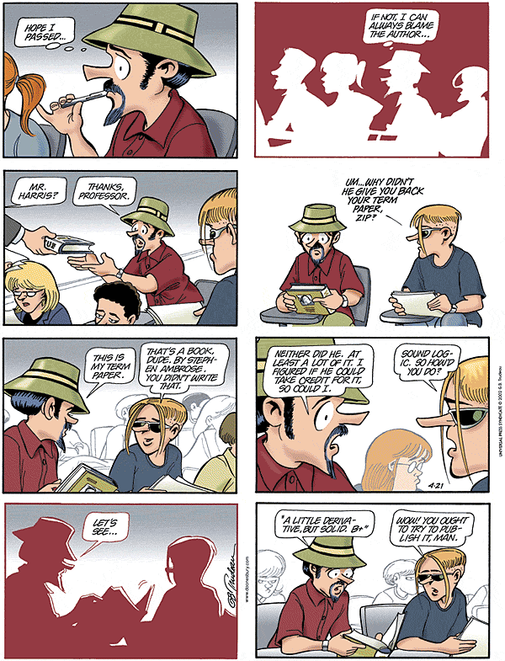

Slide 16
UVU Plagiarism Policy
http://www.uvu.edu/english/student/plagiarism.html

